Slide 1
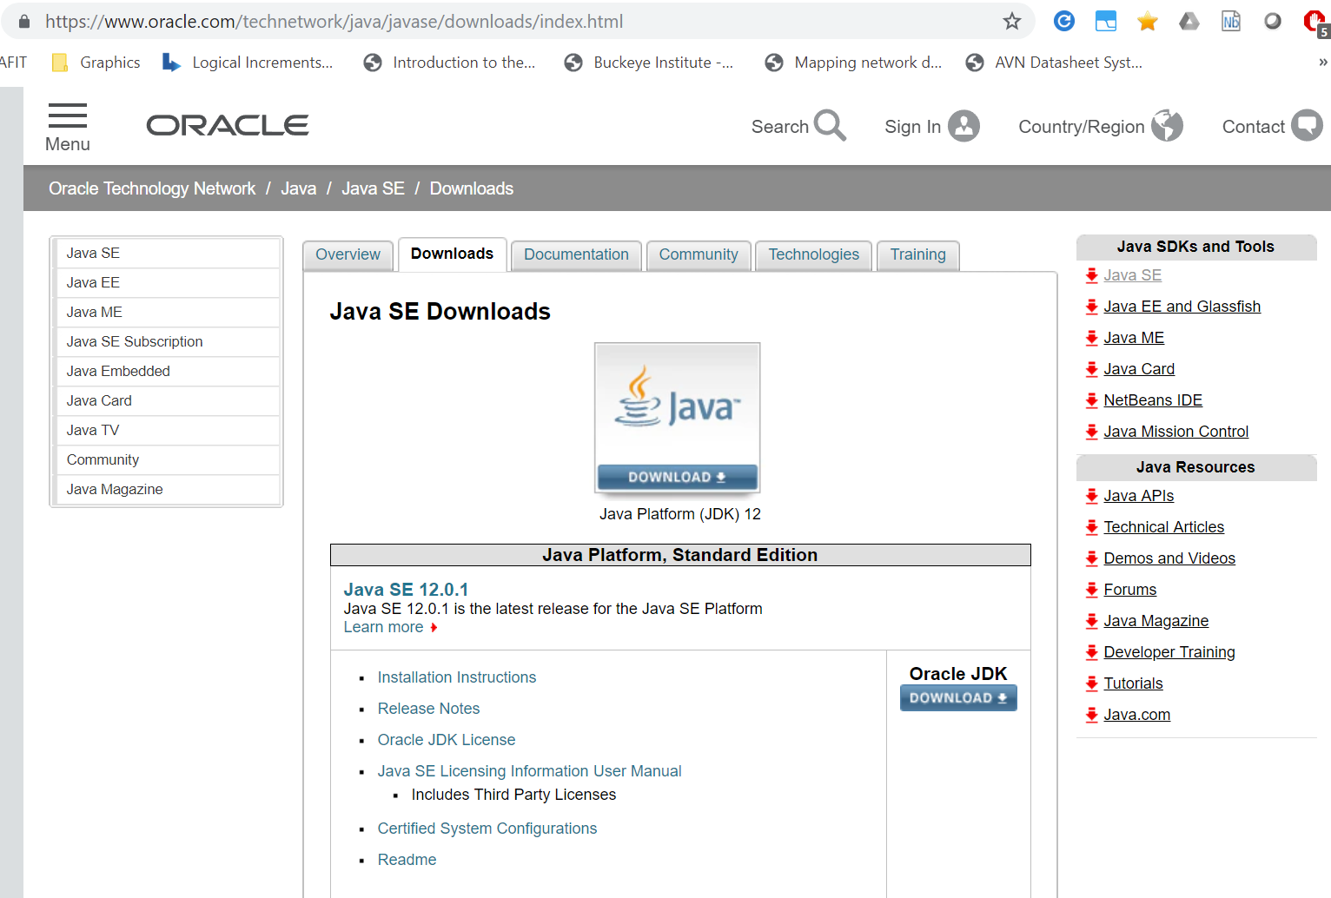
Download and install Java JDK
https://www.oracle.com/technetwork/java/javase/downloads/index.html

Slide 2
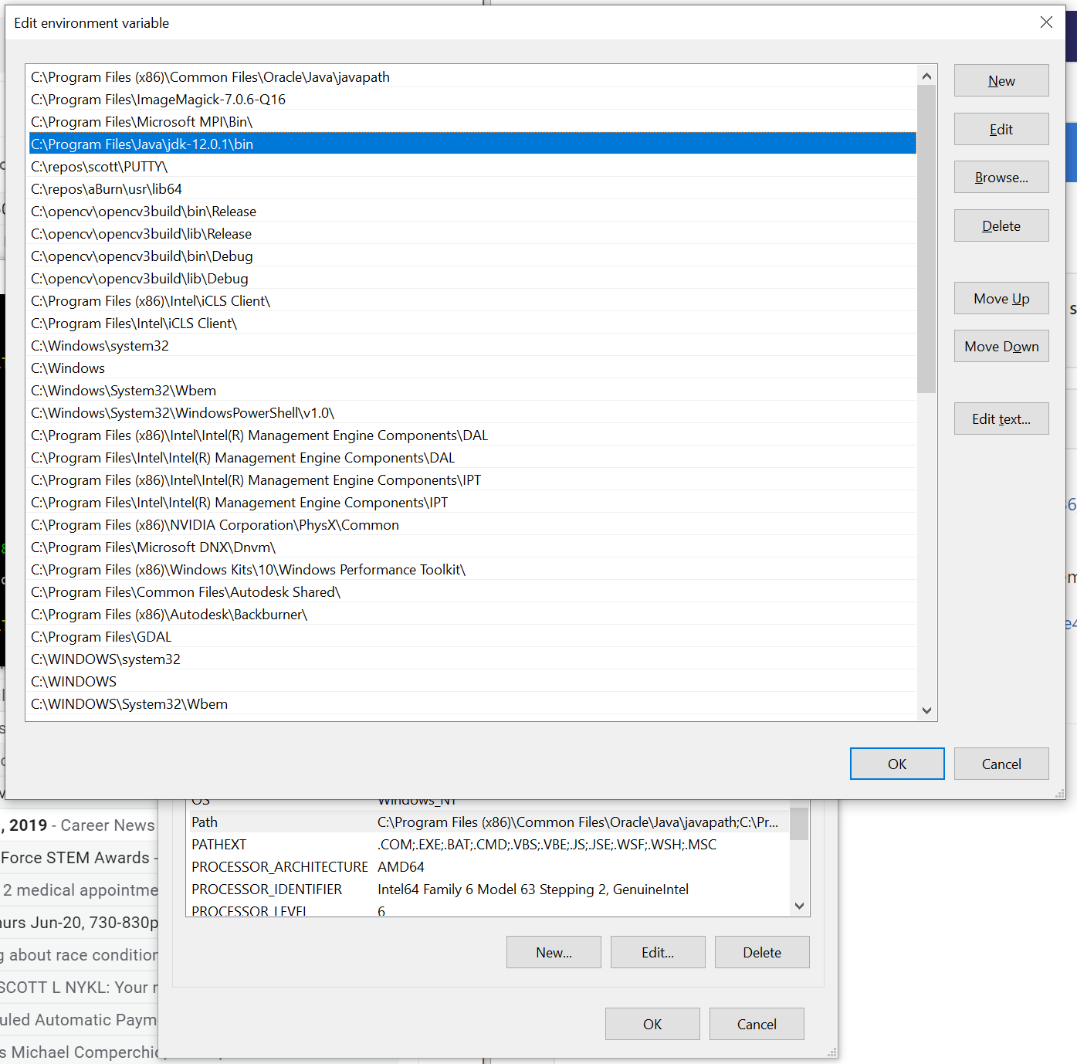
After installing the JDK, we need to add the binaries into the environment’s path
C:\Program Files\Java\jdk-12.0.1\bin

Slide 3
Test path works properly
Open an command window and type “javac” (java compiler)
C:\Users\user>javac
Usage: javac <options> <source files>
where possible options include:
Javac was found! We’re ready to code.
If you see “command not found”, the path was not entered properly, or you did not close and reopen your command window so the new setting can take effect.

Slide 4
Now download our Editor – VS Code
Download and install VS Code (Win + OS X + Linux)
https://code.visualstudio.com/download

Slide 5
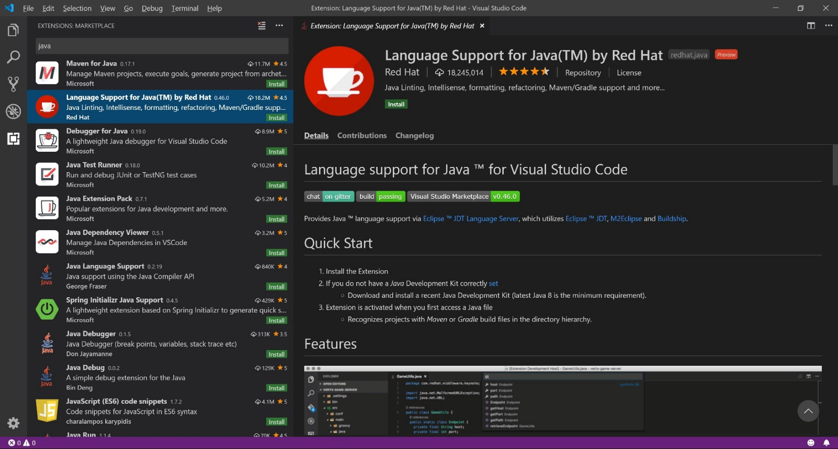
Install the Java Language Support Plugin for VS Code
In the Extensions bar (Crtl – Shift – X) search for “Java”
Choose “Language Support for Java™ by Red Hat”, Click Install

Slide 6
Set default terminal console to “integrated”
Default setting doesn’t let us type input from keyboard into the debug window. We want to change this so we have a normal terminal when we debug our programs.
File -> Preferences -> Settings
Workspace -> Extensions -> Java Debugger -> "Java > Debug > Settings: Console"
Set to "integratedTerminal" from the drop down box:

Slide 7
